Slide 1
Phishing Awareness CodeAlpha Internship
Staying Safe Online: How to Spot and Avoid Phishing Scams.
By Ahmad Tahhan

Slide 2
Brief
Introduction
Common Types of Phishing Attacks
Phishing on Social Media Platforms
Methods to Identify Phishing Attempts
Strategies for Preventing Phishing Attacks

Slide 3
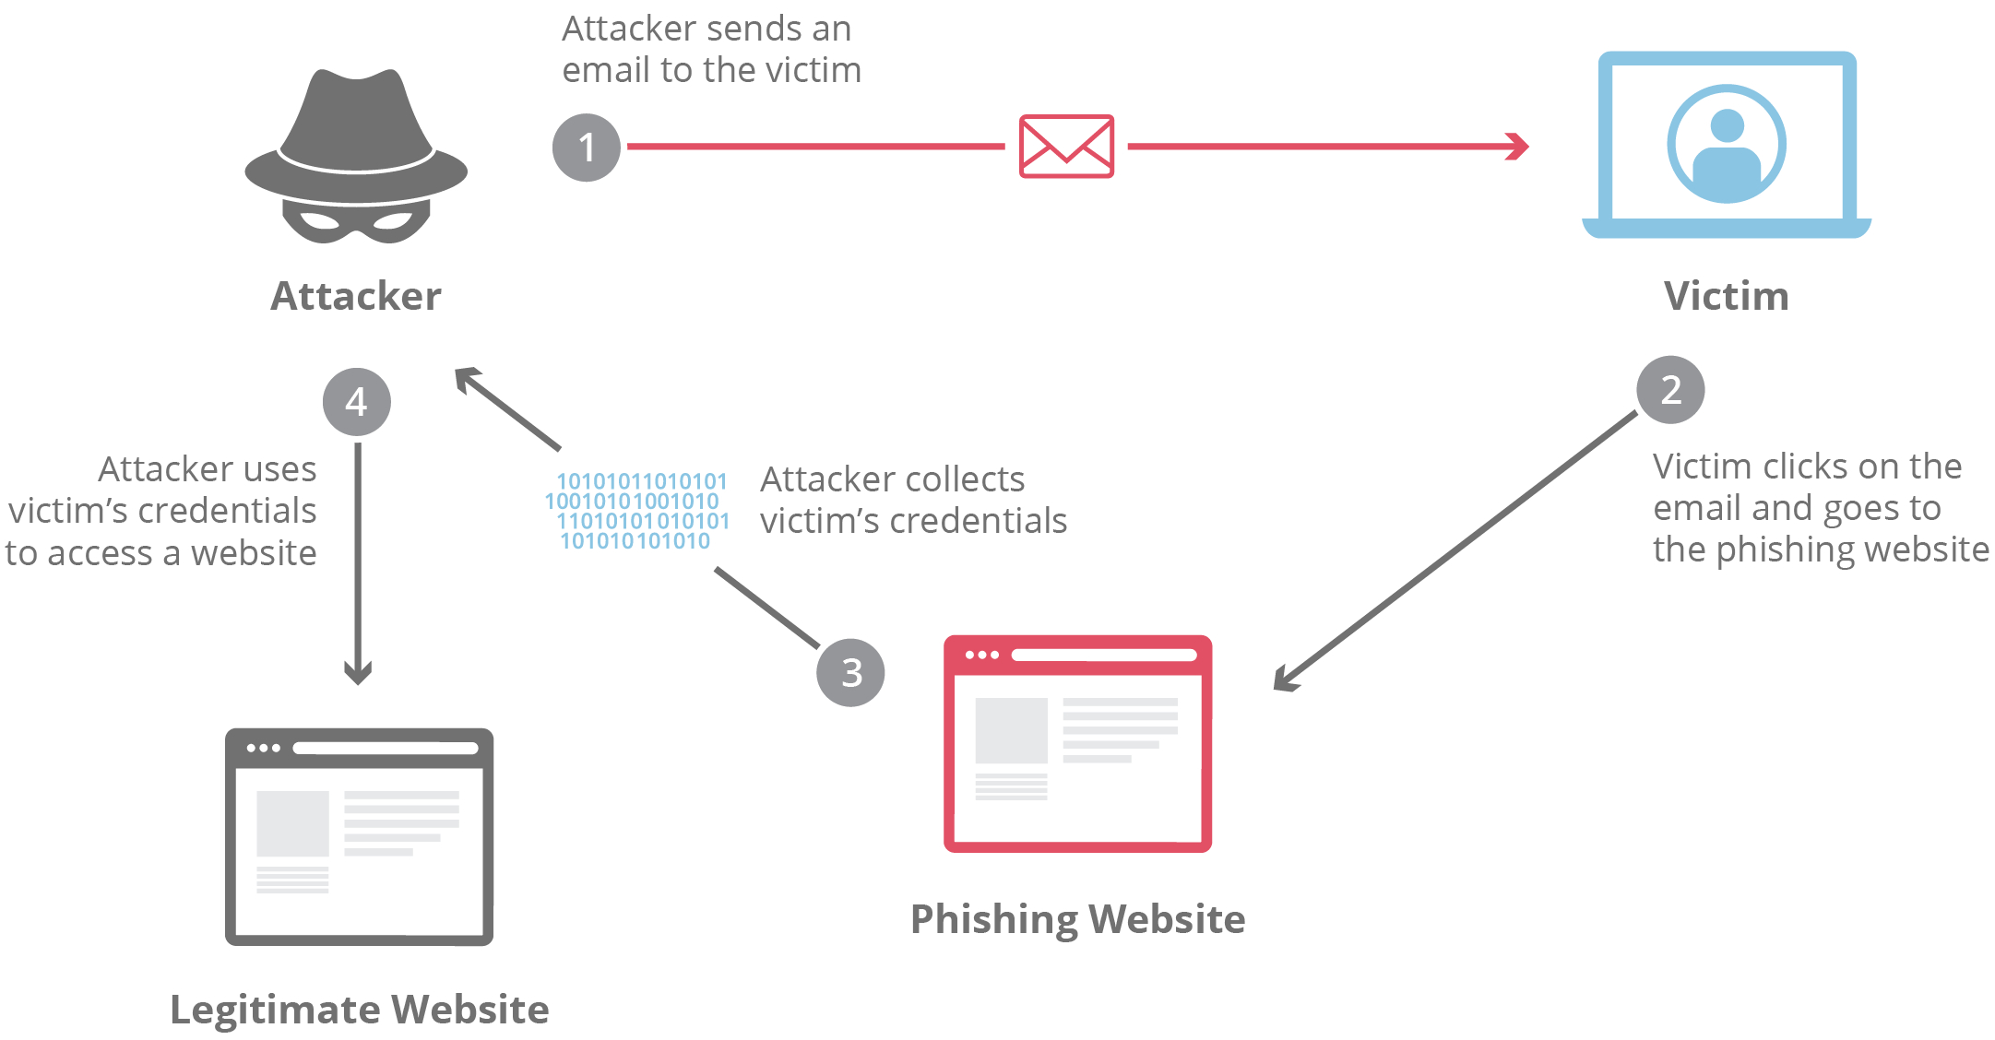
What is A Phishing Attack?
Phishing is a sophisticated form of cybercrime where attackers disguise themselves as trustworthy individuals or organizations to trick victims into disclosing sensitive information. Typically, these attacks target confidential data like user account numbers, passwords, usernames, credit card details, and online banking credentials. Phishing is predominantly carried out via email, where cybercriminals send deceptive messages containing malicious links or attachments designed to capture login credentials and other personal information. A crucial element in these attacks is social engineering, where attackers manipulate victims into believing the communication is legitimate, often by impersonating a known or authoritative entity.

Slide 4

Types of Phishing Attacks
Email Phishing: Mass-distributed emails that appear legitimate, aiming to steal personal information.
Spear Phishing: Targeted attacks using personal details to deceive specific individuals.
Whaling: High-level phishing aimed at executives to steal sensitive corporate information.
Vishing (Voice Phishing): Phishing conducted via phone calls, often impersonating trusted entities.
Smishing (SMS Phishing): Phishing attacks via text messages with malicious links or data requests.
Clone Phishing: Duplicates a legitimate email with altered links or attachments to trick recipients.
CEO Fraud/BEC: Impersonates company executives to request unauthorized transactions or data.

Slide 5
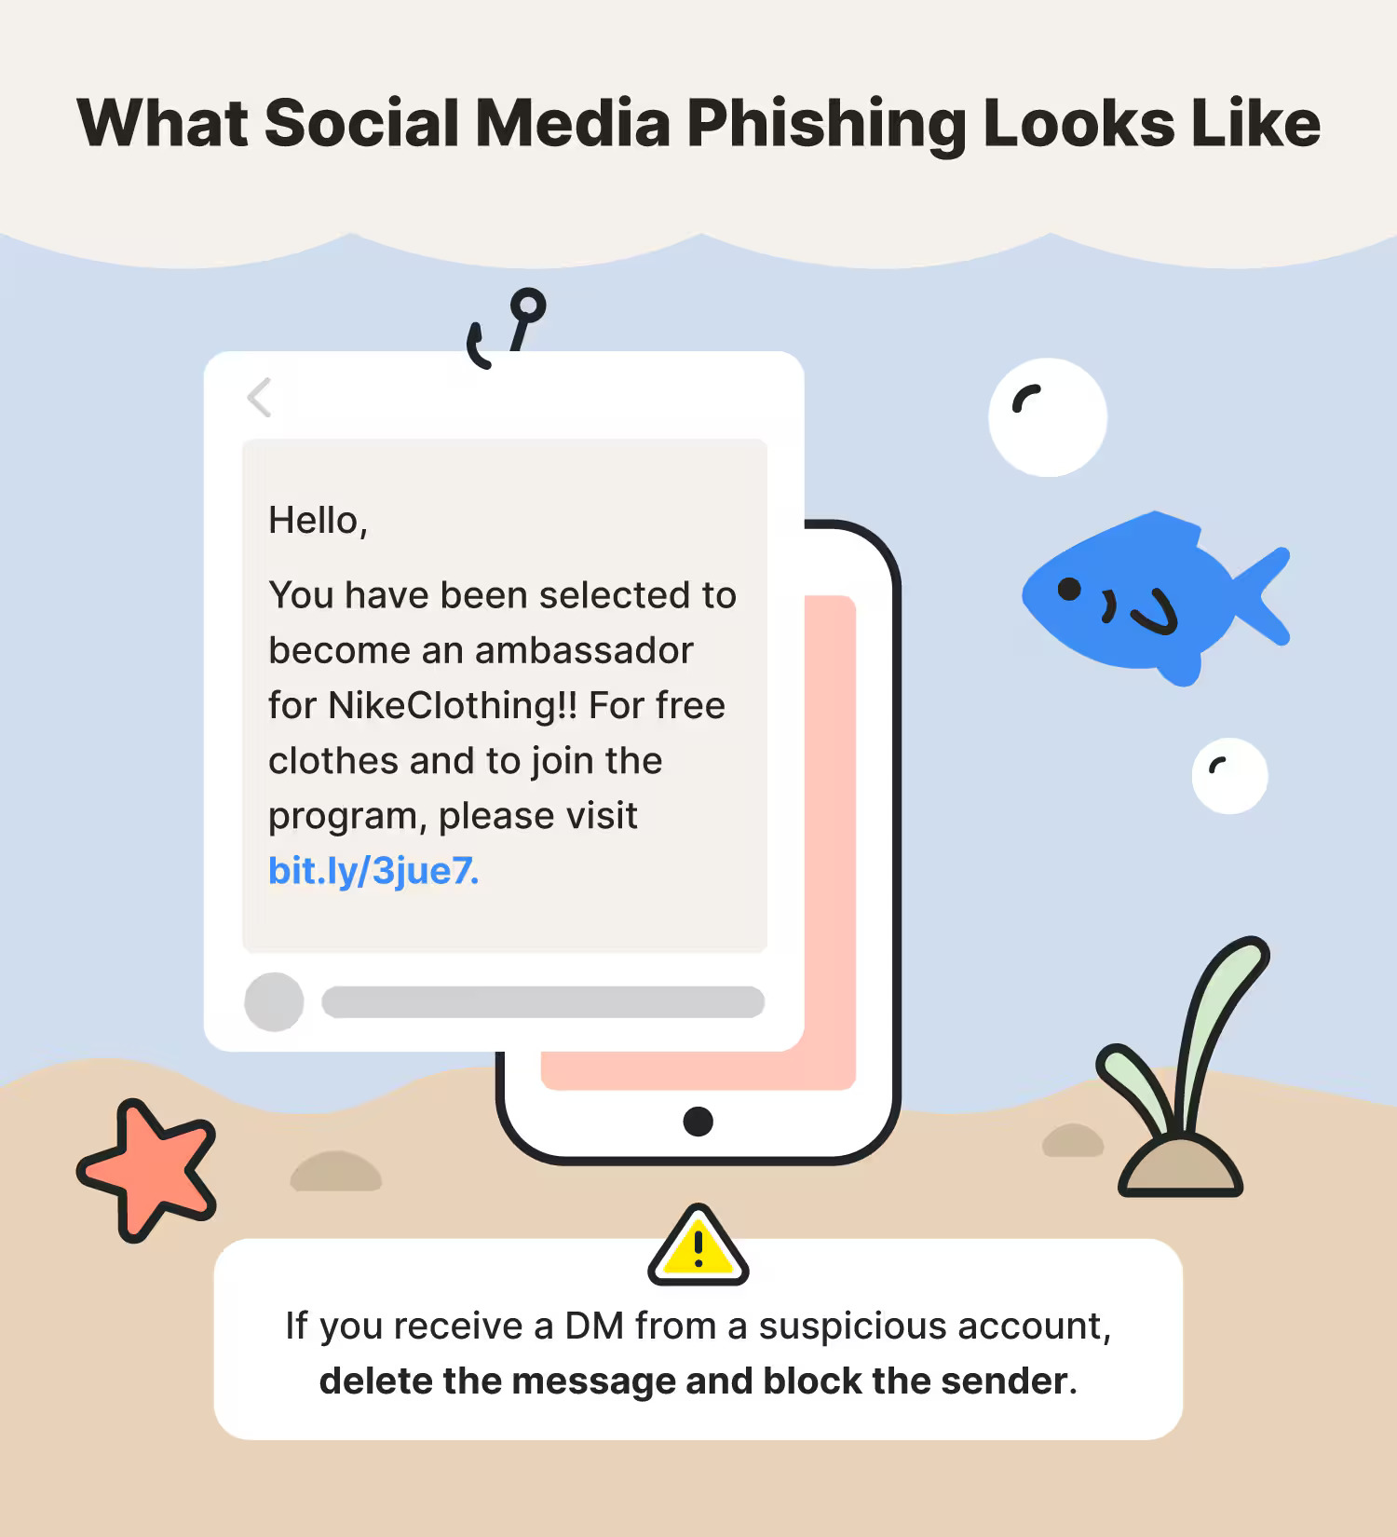
Phishing Attacks on Social Media
Deceptive Promotions: Fraudsters create fake social media profiles or hijack existing ones to run false promotions, leading users to scam sites.
Account Imitation: Attackers mimic trusted accounts to send direct messages or comments, requesting personal information or financial details.
Suspicious Links: Phishing messages often include links that direct users to fraudulent sites designed to capture sensitive data.
Phony Security Alerts: Cybercriminals send alerts claiming a security issue, urging users to verify their accounts via fake login pages.
Visual Example:
Integrate the provided "What Social Media Phishing Looks Like" image to highlight a typical phishing scenario on social media.

Slide 6
Ways to Detect Phishing Attacks
1. Inspect Email and URL Details:
Verify the sender's email address carefully for any irregularities. Legitimate organizations use official domains.
Hover over links to preview the URL before clicking. Ensure it matches the legitimate website's domain.
2. Check for Grammar and Spelling Mistakes:
Phishing emails often contain poor grammar, awkward phrasing, or spelling errors, which are uncommon in legitimate communications.
3. Be Wary of Urgent Requests:
Phishing emails often create a sense of urgency (e.g., "Your account will be suspended unless you act now!"). Legitimate organizations rarely ask for immediate action through email.
4. Use Security Tools:
Enable your browser's built-in phishing protection to block access to known malicious websites.
Use security software that offers real-time protection against phishing attempts.
5. Verify with the Source:
If you receive a suspicious email, contact the organization directly using official contact information found on their website—never through the contact information provided in the email.
6. Examine Attachments Carefully:
Be cautious of unexpected attachments, especially from unknown senders. They may contain malware designed to compromise your device.

Slide 7
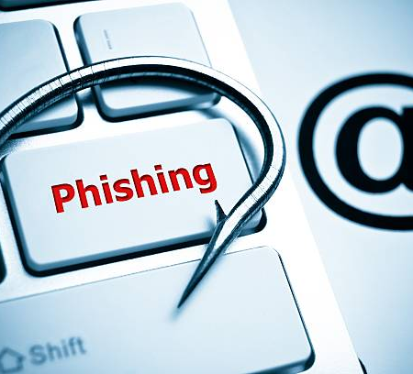
Prevention of Phishing Attacks
Educate and Train Regularly: Make sure everyone knows the signs of phishing through ongoing training.
Enable Multi-Factor Authentication (MFA): Adds an extra layer of security beyond just passwords.
Use Email Filters: Set up filters to block known phishing emails.
Keep Software Updated: Regular updates prevent vulnerabilities from being exploited.
Conduct Phishing Tests: Test employees with mock phishing emails to reinforce awareness.

Slide 8
Thank you for your attention!

